Slide 1
Using CTA data to help business owners find ideal locations to open new business
IDEO Video Interview
April 17th, 2019
H. Ada Lee

Slide 2
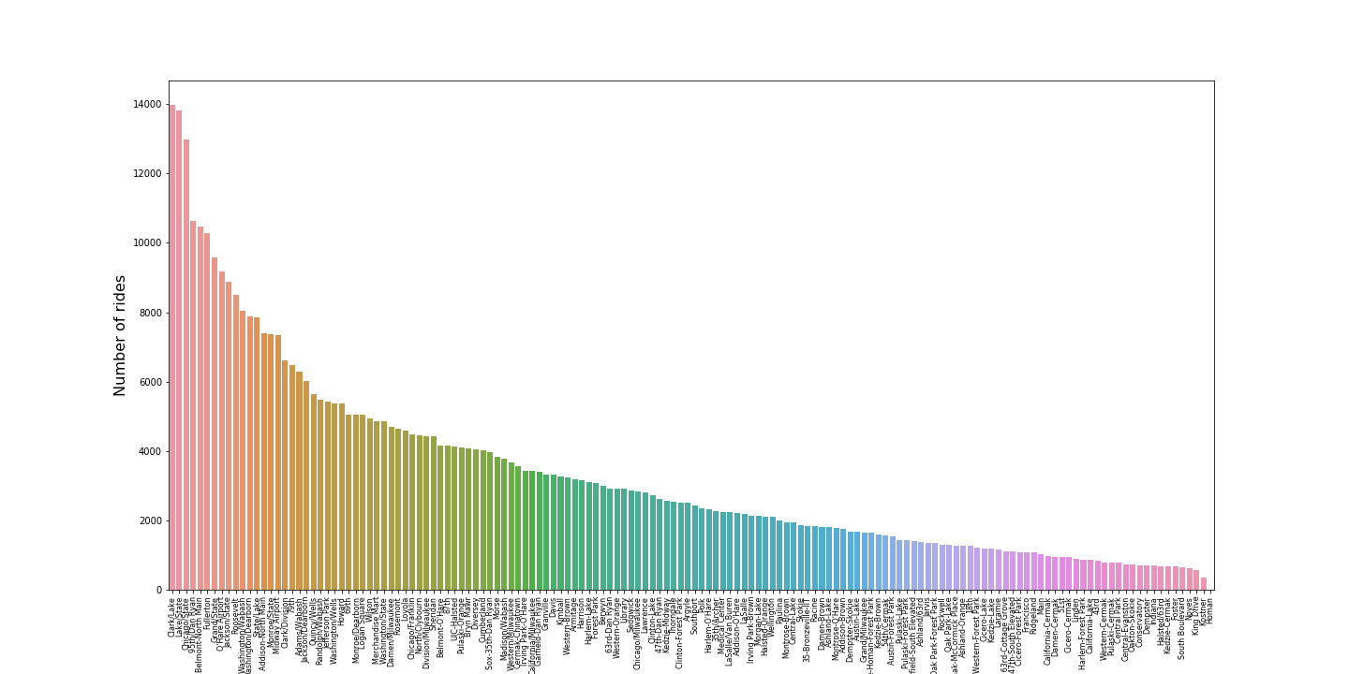
Warm Up
Clark/Lake has the highest ridership per day: 13972.55(~13973) people per day
The standard deviation of the ridership for Washington/Wabash is 2831.97 (~2832)

Slide 3
Our customer wants to open a fast food restaurant
Fast food:
Includes healthier choices like sandwich, salad and coffee
Food with high rotations of people
Suitable for business district
Maximize profit
Revenue: Sales
Cost: Rent, employment, material etc.
Propose model that can be applied to other businesses
(say the model is generalizable)

Slide 4
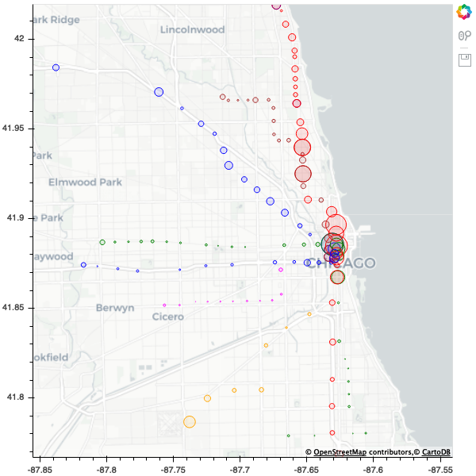
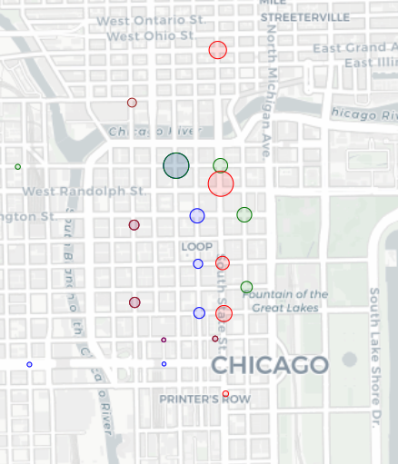
Estimate how many potential customers will be passing by the station of our interest

Slide 5
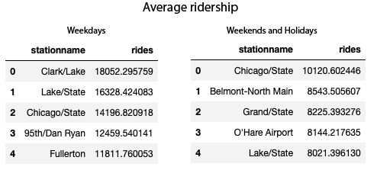
Weekday and weekend ridership show different trends
Separating weekday and weekends
The ridership data for weekday and weekends are very different
If we care about targeting office workers including weeknend data is misleading because people don’t come into office

Slide 6
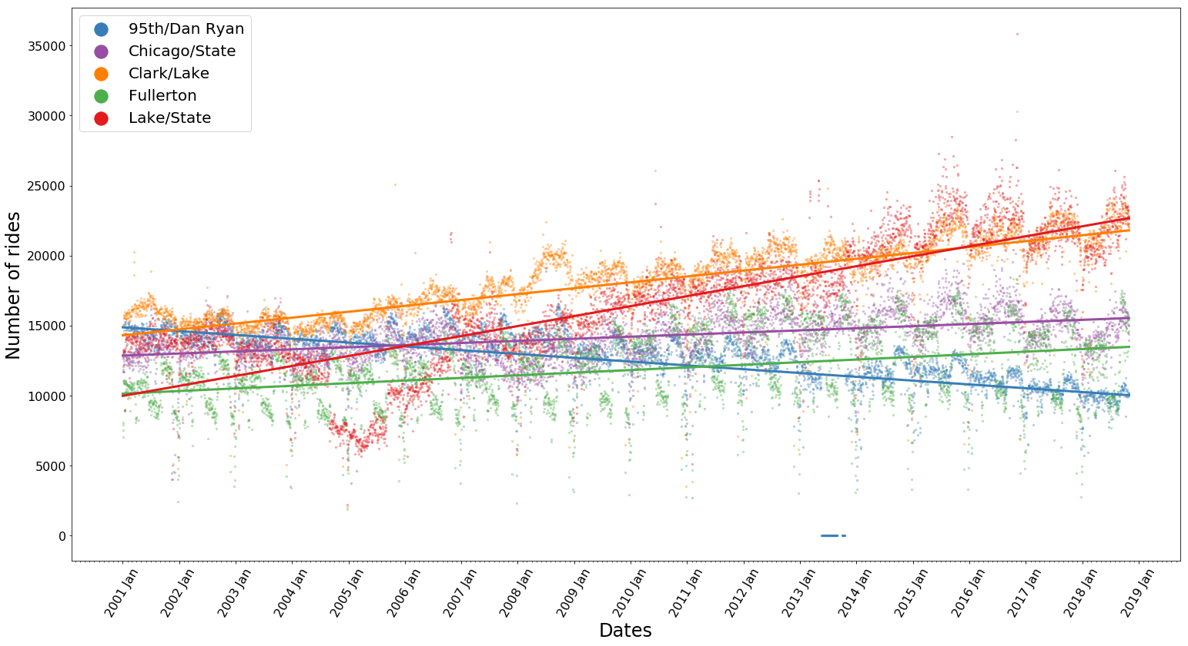
Stations with highest traffic during weekdays
Increasing trend.

Slide 7
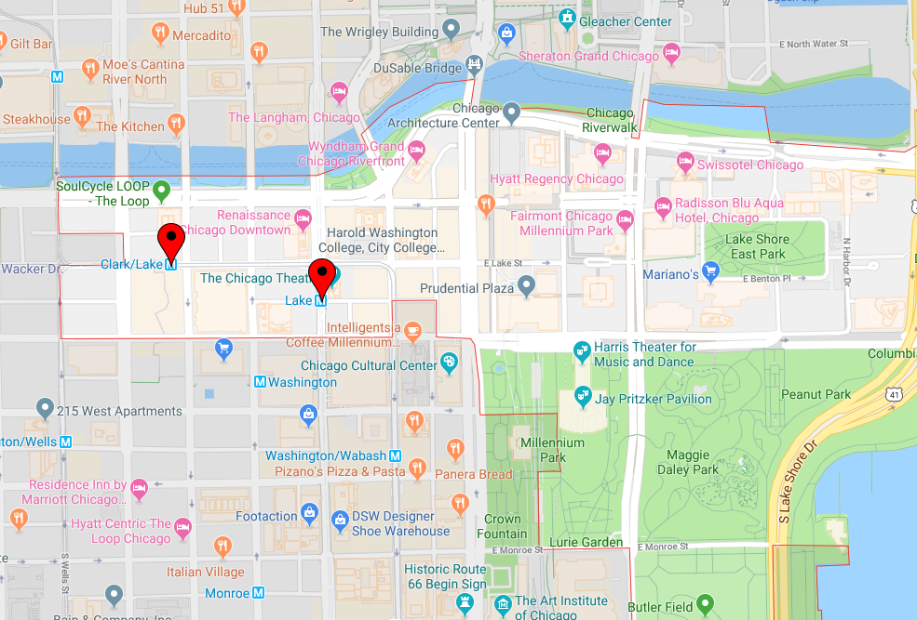
The two highest traffic stations are close

Slide 8
How saturated is the business in that area?

Slide 9
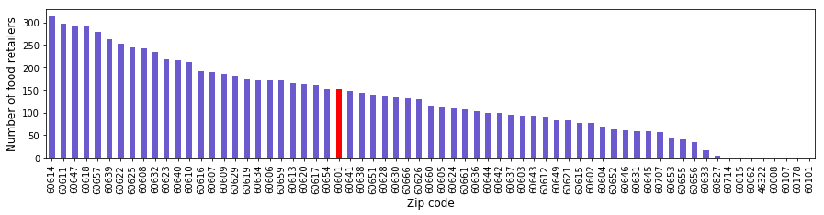
Area doesn’t have as much fast food retailors compared to other areas with less traffic
it’s ranked at 30th most fast food retailors for all the zipcodes in Chicago.
It indicates there is a growth potential.

Slide 10
Next steps

Slide 11
Revenue estimation (~ number of sales)
Traffic
Bus traffic
Foot traffic
Car traffic
Businesses in that area
Types of businesses
How many offices
Residential area?

Slide 12
Cost estimation – minimize costs
Rent
Rent estimation
Employment
Salary, rotation, number of employees
Raw materials
Sources, delivery etc

Slide 13
Thank you

Slide 14
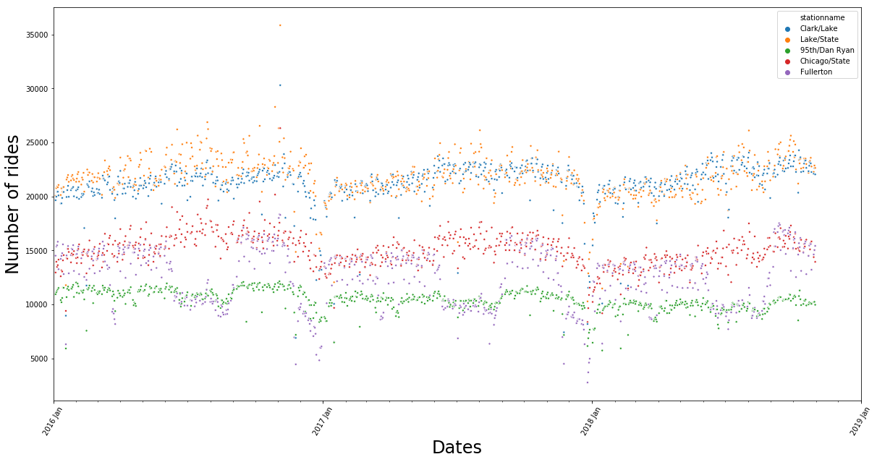
Weekday ridership focus from 2016-2018

Slide 15
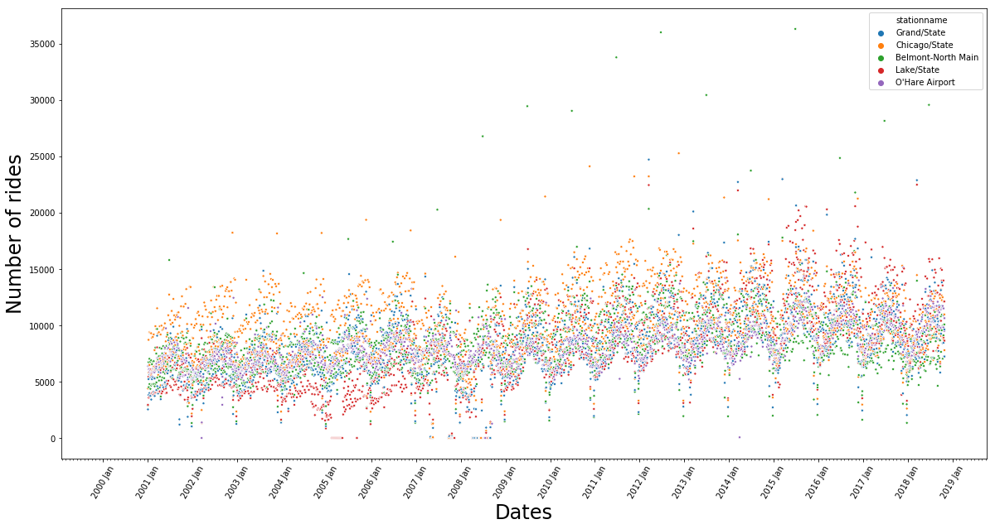
Weekend ridership focus

Slide 16
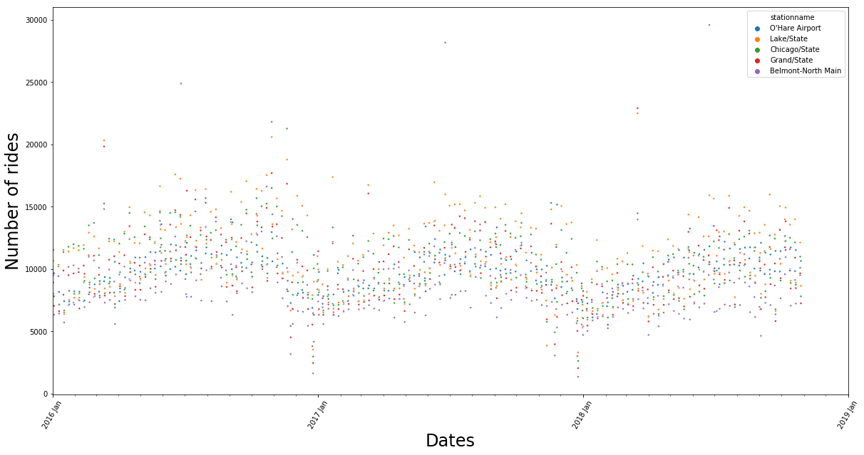
Weekend ridership focus from 2016-2018

